Slide 1
Insurance Policy Cancellations

Slide 2
Research Question
Insurance companies rely on policy revenue for their profits.
When customers cancel policies prior to a year, there is lost revenue. It is difficult to prevent this loss of revenue because we do not know who will cancel ahead of time.
This predictive model will use information known at purchase to predict who will cancel their policy.

Slide 3
Uses
An insurance company could potentially use this information for two purposes:
1.Identify the leads that are likely to cancel and do not buy those leads. That money would be better spent of buying leads for customers who will be less likely to cancel.
2.After a policy is purchased, identify those who are most likely to cancel. Then have targeted interactions with them aimed at preventing cancellations e.g. payment reminders, phone calls to ensure satisfaction.

Slide 4
Approach
Data Wrangling: Make sure data is organized in the best way possible
Exploratory Analysis: Significance testing and graphing
Modeling: I’m going to predict a binary variable (Cancelled or Not Cancelled) using a general linear model, random forest, and support vector machine.

Slide 5
Results: Exploratory Analysis
The following significance levels were found for the variables in the data.
Variable Name | Statistical Significance
agent | 2.2E-16
bi_limit | 2.2E-16
cost_per_vehicle | 2.2E-16
currently_insured.x | 2.2E-16
customer_age | 2.2E-16
education | 3.406E-12
gender | 2.088E-15
lead_seller | 2.2E-16
LQ_FB_PREM_AMT | 2.2E-16
marital_status | 1.373E-14
Months_Coverage | 2.2E-16
no_of_vehicles | 0.00009354
number_of_accidents | 0.02133
number_of_claims | 0.1504
previous_policy_type | 2.2E-16
risk_profile | 2.2E-16
SameDay_vs_Followup | 2.025E-13
State | 2.2E-16
vehicle_ownership | 0.3385

Slide 6
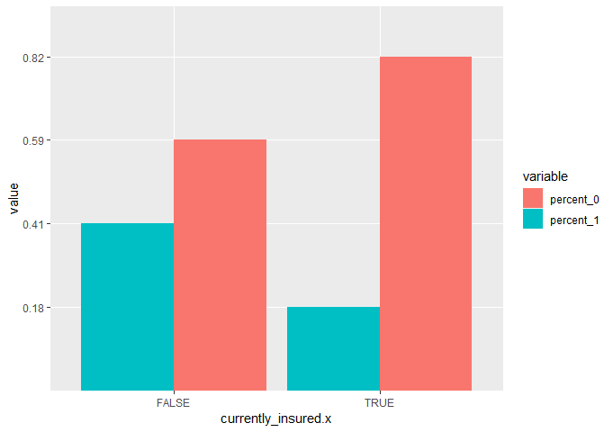
Results: Exploratory Analysis

Slide 7
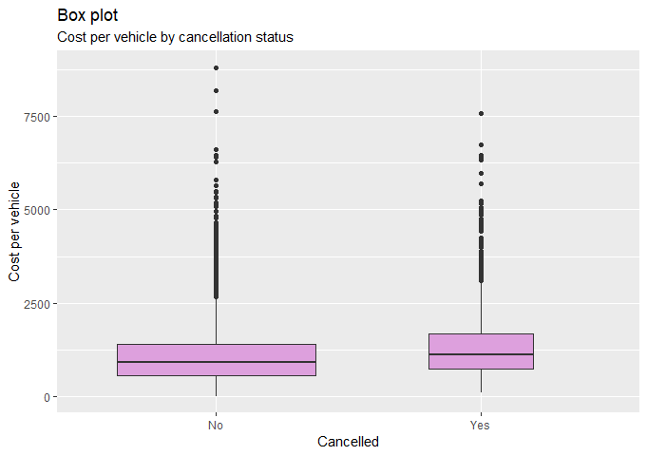
Results: Exploratory Analysis

Slide 8
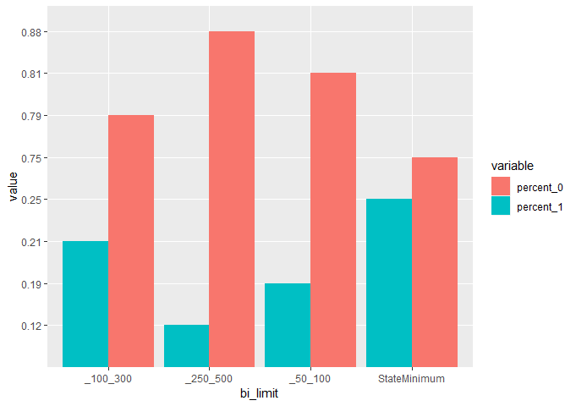
Results: Exploratory Analysis

Slide 9
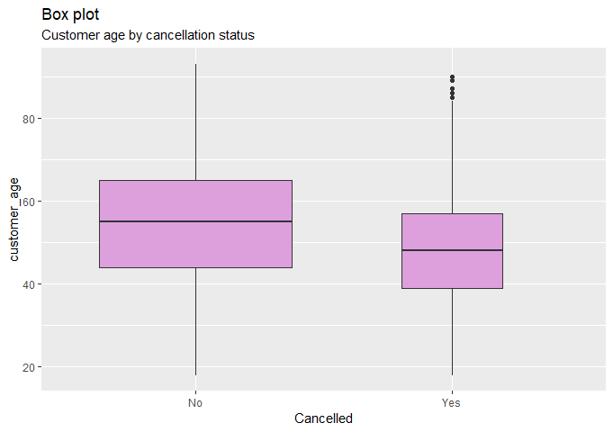
Results: Exploratory Analysis

Slide 10
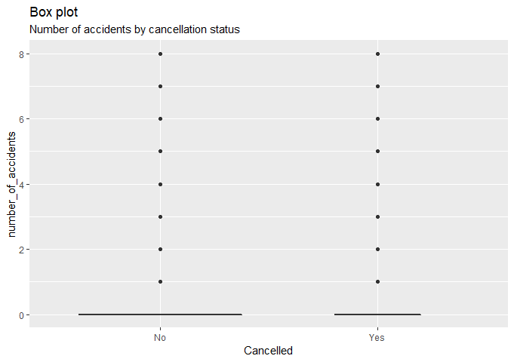
Results: Exploratory Analysis

Slide 11
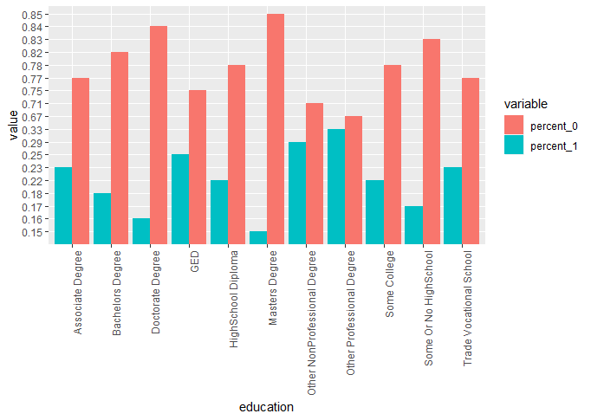
Results: Exploratory Analysis

Slide 12

Results: Exploratory Analysis

Slide 13
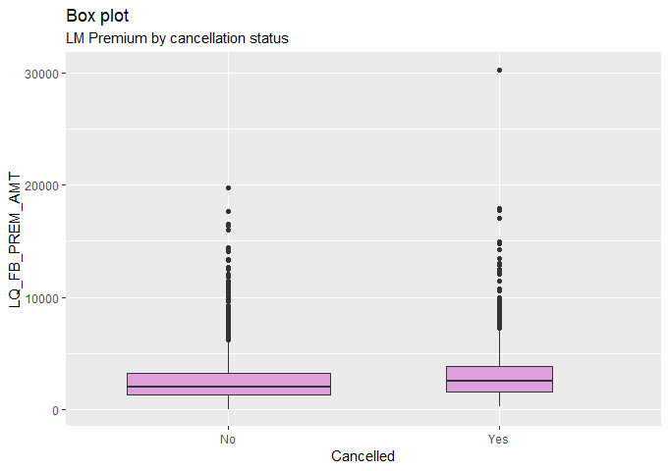
Results: Exploratory Analysis

Slide 14
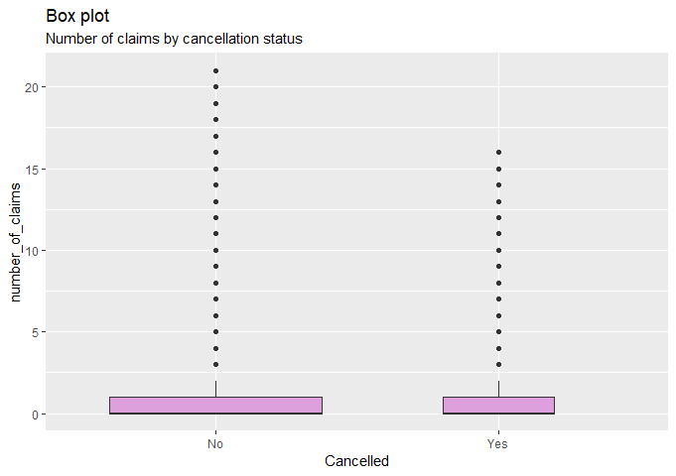
Results: Exploratory Analysis

Slide 15
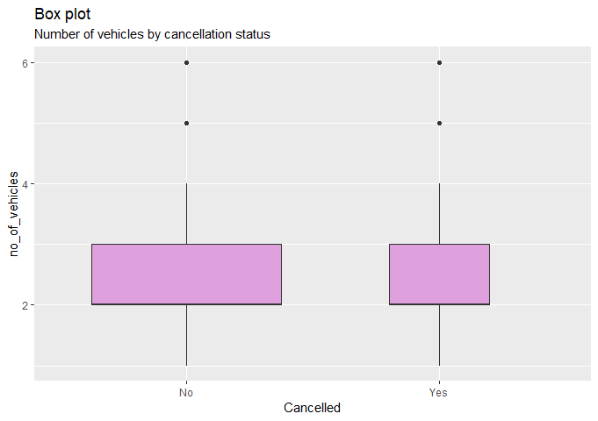
Results: Exploratory Analysis

Slide 16
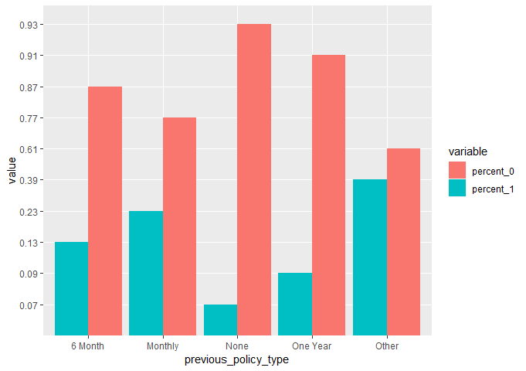
Results: Exploratory Analysis

Slide 17
Results: Exploratory Analysis

Slide 18

Results: Exploratory Analysis

Slide 19
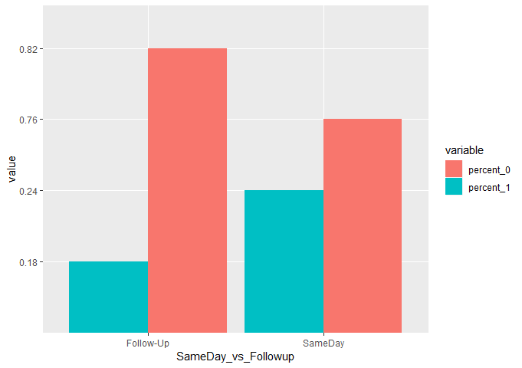
Results: Exploratory Analysis

Slide 20
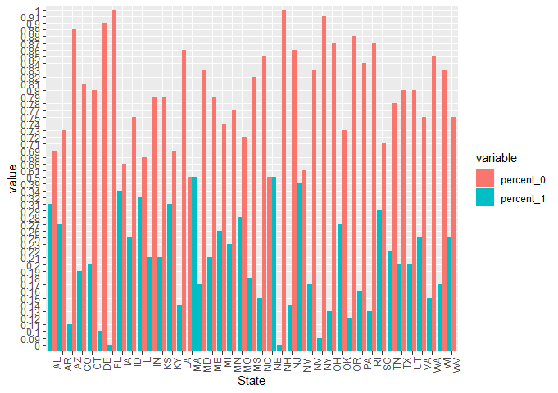
Results: Exploratory Analysis

Slide 21

Results: Exploratory Analysis

Slide 22
Results: Exploratory Analysis

Slide 23
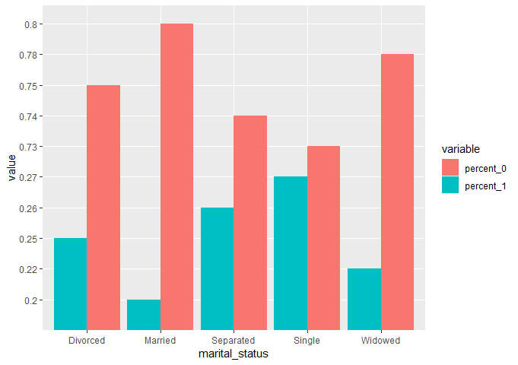
Results: Exploratory Analysis

Slide 24
Results: Predictive Modeling
 | GLM | Random Forest | SVM
Accuracy | 0.7857 | 0.7839 | 0.7831
P-Value | <2e-16 | <2e-16 | <2e-16
Confidence Interval (95%) | 0.7698, 0.8011 | 0.7679, 0.7993 | 0.7671, 0.7985
Sensitivity | 0.9887 | 1.000000 | 1.0000
Specificity | 0.0529 | 0.003413 | 0.0000

Slide 25
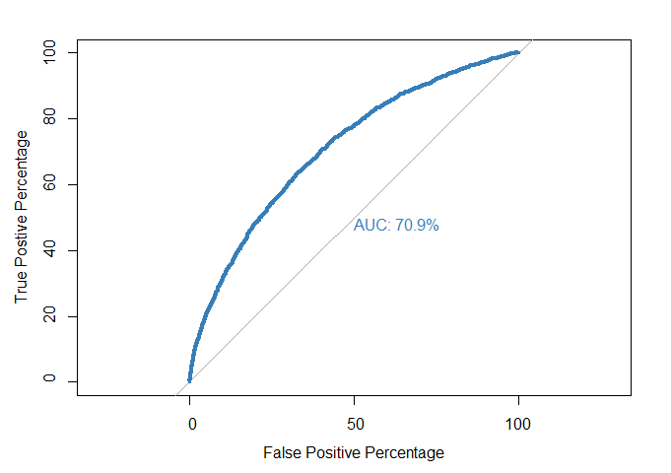
Results: Predictive Model
Due to the high level of accuracy of the GLM, the ROC curve was generated to confirm it’s use for this data.

Slide 26
Conclusions
The general linear model appears to be the best model for use in this data set.
The metrics suggest this model is predictive and will be useful for identifying cancellations before they occur.

